Slide 1
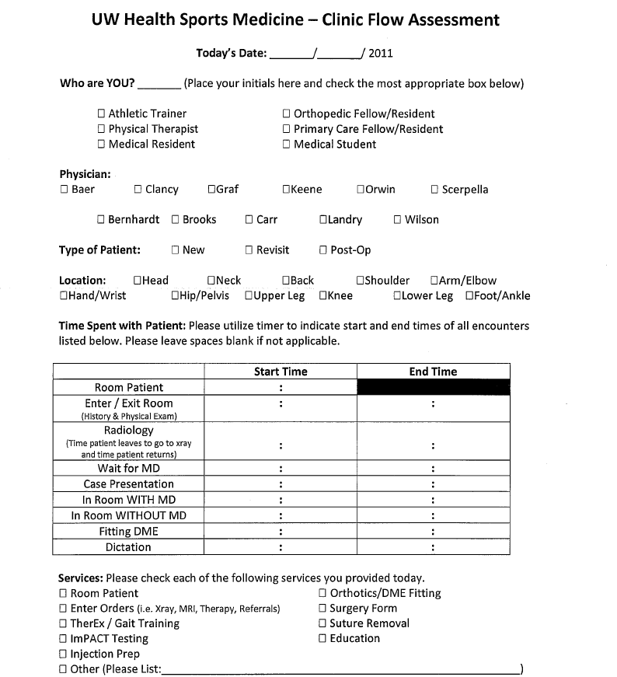
The Impact of Athletic Trainers in a Sports Medicine Clinic: Improving Efficiency and Productivity
Shari Khaja, MS, ATC; Joseph Greene, MS, ATC; John Wilson, MD, MS
University of Wisconsin Hospitals and Clinics, University of Wisconsin School of Medicine and Public Health,
Department of Orthopedics and Rehabilitation, Madison, Wisconsin
Background
This quality improvement study objectively quantified time spent on tasks for physician extender staff. Physician extender types included athletic trainers (ATC), and non-athletic trainers (physical therapists, orthopedic and primary care resident and fellow physicians). The data was collected on a large cohort of 1542 patient encounters (n=1408 ATC, n=138 non-ATC) at the UW Health Sports Medicine Clinic in Madison, WI. The practice is a high volume academic sports medicine center comprised of 5 primary care sports medicine (PCSM) physicians and 6 orthopedic sports medicine (OSM) surgeons. The clinical model employed 3 PEs per surgeon clinic and 2 PEs per primary care physician clinic.
Specific Aims
To determine the specific impact of physician extenders on a sports medicine practice.
To determine the time on task spent by various types of physician extenders on the complete range of tasks included within the delivery of patient care
To determine which type of physician extender provider delivered the most efficient and effective care in our delivery model.
To identify opportunities to increase physician value added time. Value added time is defined to be time with patients and the opportunity to see more patients.
To establish baseline data for each portion of a standard physician visit.
Methods
For a total of eight weeks - March 7th through April 29^{th,}, 2011, each physician extender was required to fill out an informational clinic flow assessment for every patient encounter (Figure #1)
PEs completed a self-report work diary (Figure #1) in which they recorded time on-task (TOT) for 8 common task categories: 1) rooming patients, 2) performing history and physical examination, 3) radiology, 4) waiting for physician, 5) presenting case to physician, 6) time spent with physician in the room, 7) time spent on patient education without physician in the room, 8) fitting durable medical equipment, 9) dictating/scribing. Clinic visit type was categorized as “new”, “revisit”, or “post-operative”. Average TOT was determined for each task category for each of the PE types. Descriptive statistical analyses were performed.
Figure 1.
Figure 1.
 | AT | Non-AT
History/Phys. Exam | 8.67 | 12.57
Case Presentation | 1.94 | 2.36
Patient Education | 2.40 | 1.11
Documentation | 4.03 | 6.23
 | 17.04 | 22.27
Figure 2.
B
B
P
Figure 3.
Conclusions
A sports medicine patient care delivery model that effectively employs PEs resulted in improved physician efficiency, by reducing time spent in physician non-essential activity during each patient visit. This time savings could be used to improve patient throughput, thereby increasing patient access to physicians and revenue generated. Our findings indicate that the athletic trainer is the most efficient physician extender provider in our clinic setting.
Time acquisition was consistent across all extenders, as we utilized the time indicated through the electronic medical record. The assessment forms were then collected and entered into a database for future statistical analyses.
Results
Significance
The importance of efficient and effective delivery of care cannot be underestimated in high volume specialties like orthopedics and sub-specialties like sports medicine. Understanding the tasks that physicians and support staff should perform is critical as more and more demands are placed upon the care delivery team. Physician value added activity must be agreed upon and maximized. Non value added activity must be minimized or eliminated.
Future quality improvement studies should center upon the measurement of both patient satisfaction and physician satisfaction in models that utilize physician extenders to support patient care. These results could be compared to practices that utilize physician extenders in more limited roles. Additionally, future work in this area should also continue to evaluate opportunities to use extenders in capacities that maximize patients access and patient throughput in not only sports medicine, but in other subspecialties of orthopedics as well.
The mean total clinic visit length was 34.41±17.23 minutes (m) for PCSM and 41.72±15.16m for OSM, and the mean TOT was 23.87±29.77m and 30.40±33.25m respectively. “New” encounters had the greatest mean TOT (33.39±10.73m) followed by “revisit” (23.26±1.76m) and “post-operative” (17.98±8.29m).Average physician essential activity (review of records, case presentation, and direct patient care) was similar between PCSM (11.4±5.65m, 33% total clinic visit) and OSM (10.27±6.36m, 24.6% total clinic visit) surgeons. (Chart #1) ATC PEs had lower mean TOT per visit (25.78±11.32m) compared to non-ATC PEs (32.06±9.42m), a difference of 6.28±1.9m per visit (Chart #2). ATC PEs have lower average TOTs on all patient care tasks, except on patient education where they spend an average of 2.40m compared to 1.11m for non-ATC PEs (Chart #3).

